Slide 1







Mahatma Education Society’s
Pillai HOC College of Arts, Science and Commerce
Pillai HOCL Educational Campus, Rasayani
(NAAC Accredited ‘A+’ Grade, CGPA- 3.26 in Cycle 2 & ISO 9001: 2015 Certified)
Paper Presentation
Title: AI Based Multifunctional Robot
Guided By
Ms. Darshana Wajekar
Name: Ankita Panpatil
Class: S.Y.MSc.IT

Slide 2

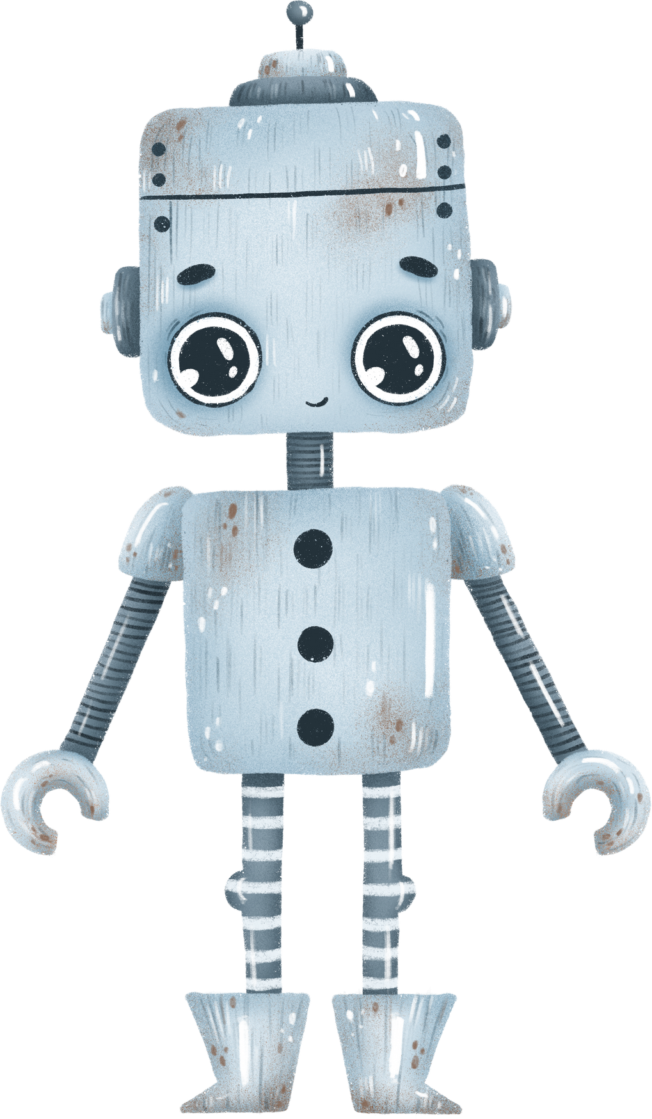

Outline
What is a robot?
Asimov's Laws
Communication of Bolt Devices with Bolt Cloud
Algorithms used in the project
Hardware Requirement
Software Requirement
Objective
Conclusion
Output

Slide 3
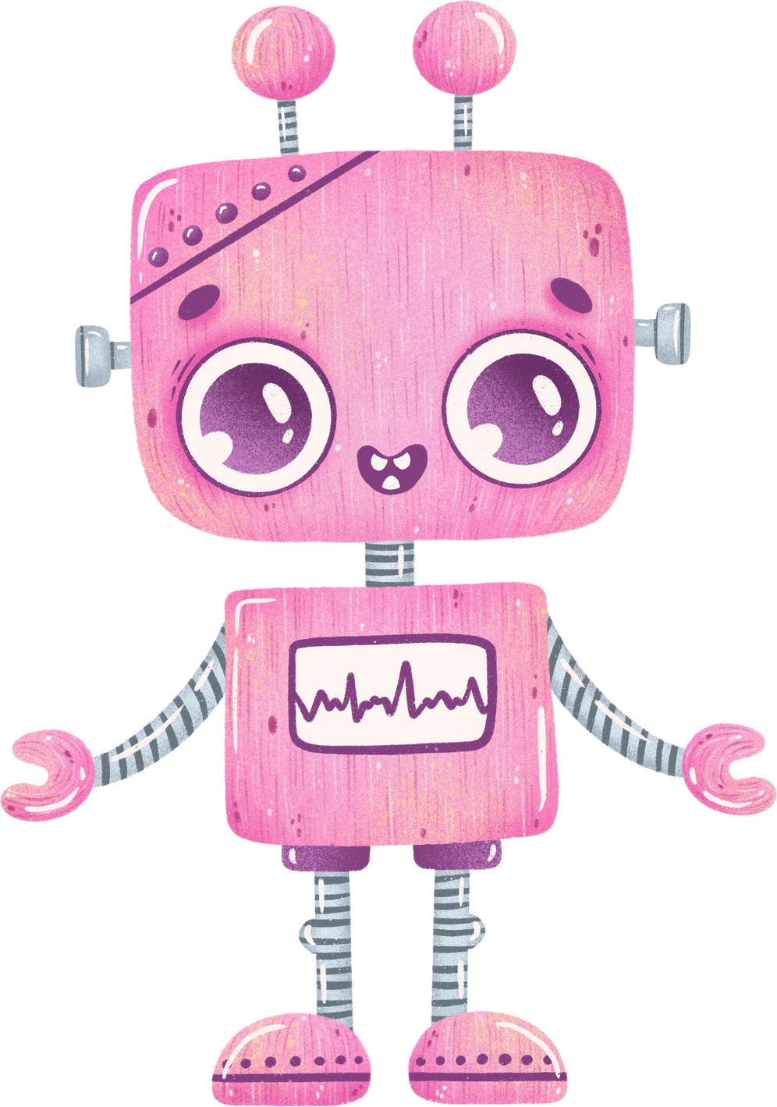

What is a robot?
A robot is an automatically guided machine capable of making decisions required to do a task, by monitoring, navigating through and manipulating its environment.
The word Robot is derived from a Czech word Robota’ which means ‘forced labor or a slave’.
The plant monitoring robot carries with it all the sensors required to monitor the environment, sampling the environment data at different pre-determined locations.
It then transmits this data via the Bolt WiFi module to the Bolt Cloud. With this robot you can monitor upto 6 different locations for, light/temperature or any other environment variable.

Slide 4

Asimov's Laws
Asimov’s Three Laws of Robotics:
A robot may not injure a human being or through inaction, allow a human being to come to harm.
A robot must obey the orders given to it by human beings except where such orders would conflict with the First Law.
A robot must protect its own existence as long as such protection does not conflict with the First or Second Law.

Slide 5
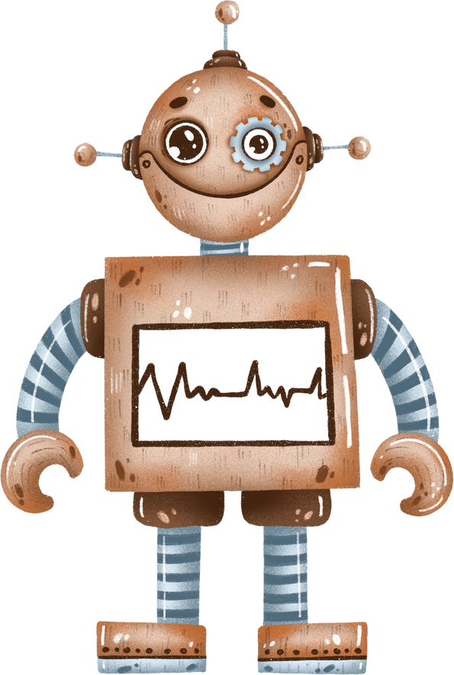
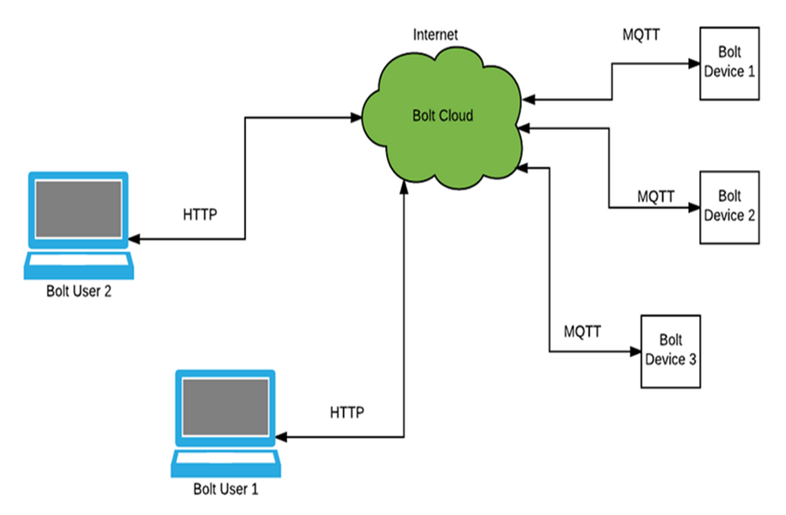

Communication of Bolt Devices with Bolt Cloud
The Bolt Cloud is one of the major component in providing the IoT capabilities to the Bolt device.
All the Bolt devices connect to the Bolt Cloud out of the box.
The Bolt devices are shipped with a firmware that helps it understand how to connect to the Bolt Cloud over the Internet.
Most IoT devices and sensors contain limited processing capabilities and constrained Internet bandwidth.

Slide 6


Algorithms used in the project
Obstacle avoiding algorithm
Wall following algorithm
Hand following algorithm
Plant monitoring robot

Slide 7
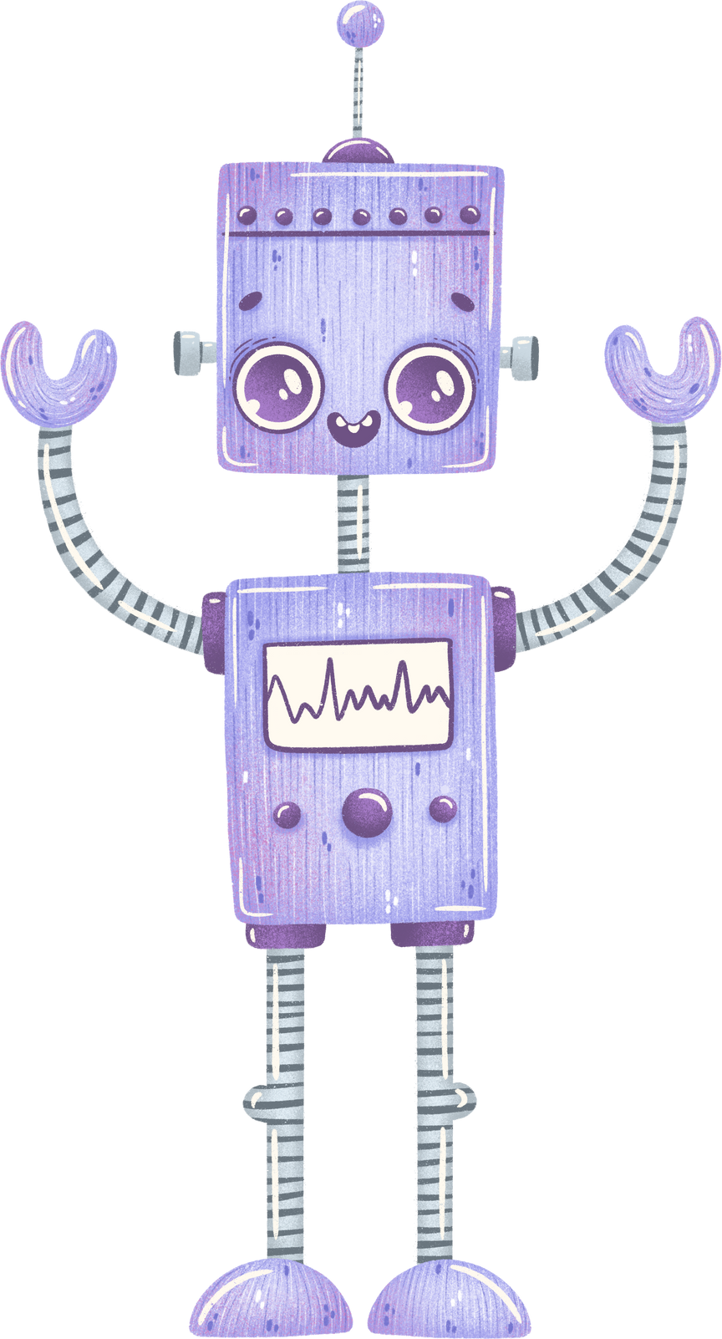
Hardware Requirement
Bolt WiFi Module
3.3V
Obstacle sensor
Check if an obstacle is present
USB Cable
5V
DC power supply
Connect to electricity board
3 pin female to female merge pin connector
3 pin female to female merge pin connector
Connect to circuit
Double sided tape
stick it to the lower side of the sensor
Mechanical components box
To place the robot on

Slide 8

Software Requirement
OPERATING SYSTEM
Windows 7 Or Above
TECHNOLOGY
Javascript
BROWSERS
Google Chrome
EDITOR
Arduino Sketch

Slide 9

Objective
Build an energy saving Plant monitoring robot with integrated sensors and controllers
Design a Plant monitoring robot with modular approach design, which makes the system scalability and expandability.
Design a Plant monitoring robot which compatibility and scalability with other commercial product and automation system, which might include more than lighting systems.

Slide 10
Conclusion
This project is based on the principle that whenever the light falling on the sensor changes, the resistance of sensor changes which is then converted into a change in voltage.
The ADC pin on Bolt WiFi Module converted this analog voltage level into digital values which are shown on the graphs.
We connect the LDR between 5v pin and the analog input pin (A0), so that when light intensity increases, the resistance of LDR decreases so the voltage across the LDR decreases and as a result, the voltage on the analog input pin increases.

Slide 11
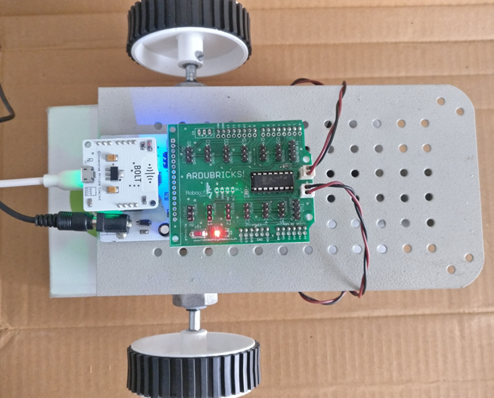



Output

Slide 12
Thank you

